Slide 1

Online Encounter 20
Notes:
ENCOUNTER 20
REVIEW STUDENT PROGRESS
Check for last Encounter attendance.
Check for last Speaking Center attendance and time spent.
Check that Lesson 3 has been completed.
Prepare general comments on Student attendance, study habits, and overall progress.
VIDEO SUMMARY
Khae bumps into Mrs. Berry in the hallway outside her apartment. Mrs. Berry asks Khae about her plans for the day and asks her to run some errands for her. Mrs. Berry gives Khae a lot of money to cover the cost of the errands. Khae goes to the post office, the department store, and the supermarket.
Eli comes to visit Sofi at the restaurant, and they chat for some time. After he eats, Eli leaves a very large tip, along with a thank-you note for Sofi and Diego.
Benny lends Shen a spandex bodysuit to wear for his first night as a doorman. Shen is deflated when he realizes that there is no acting involved. He works the door and meets many famous people, although Dan Blaze does not make an appearance, much to his dismay.
VOCABULARY OBJECTIVES
Can name very well-known nations, nationalities, and languages (Canadian; American; British; French; Thai; Chinese; Russian; German; Spanish; Mexican; Italian)
GRAMMAR OBJECTIVES
Can describe facts and states with the present simple, but with limited control (He's nice and he wants to talk to you.)
Can use what, where, when, why and how to ask for information (When do you visit your parents?)
Can name very common nationalities based on country names (Is he American?)
SPEAKING OBJECTIVE
Can ask and answer simple questions about people they know in a limited way (Sofi, what’s that man’s name?)

Slide 2

Encounter 20
Introductions
Your teacher
My name is .
Now please introduce yourself.
Notes:
INSTRUCTIONS
This is a warm-up activity and should not be assessed.
Introduce yourself to the Students. Then ask each individual Student what his/her name is. Tell the Students:
Hello. My name’s _______. What’s your name?
Sample Responses: My name’s _______. / My name is _______.
TEACHING TIPS
Ask the Students about their study habits. (i.e., “Have you finished your Speaking Center Lessons? How about your Student Manual or Digital book?”)
Check for IT issues.

Slide 3

Part 1.0: Warm-Up
things you can eat
things you can wear
countries in Europe
Notes:
1.1 Categories (5 min)
Allow five minutes for this slide.
OBJECTIVE
To help the Students relax and start thinking in English
INSTRUCTIONS
#1. Draw the Students’ attention to the cue at the top of the screen [things you can eat]. Have the Students name as many things one can eat that they can think of. Aim to get 10 words for this category.
#2. Reveal the second prompt. [things you can wear]. Again, have the Students name as many things in the category as they can think of.
#3. Reveal the third prompt. [countries in Europe]. Again, have the Students name as many things in the category as they can think of.
TEACHING TIP
This is a warm-up activity and should not be assessed.

Slide 4

Part 2.0: Target Language
Activity 2.1: Context Creation
Do you know where I’m from?
Canada.
You’re from
That’s right. I’m from Canada, so what am I?
.
You speak English
What language do I speak?
.
You’re Canadian
Notes:
2.1 Where Are They From? (10 min)
Allow two minutes for this slide.
OBJECTIVES
Can name very well-known nations, nationalities, and languages (Canadian; American; British; French; Thai; Chinese; Russian; German; Spanish; Mexican; Italian)
Can name very common nationalities based on country names (Is he American?)
INSTRUCTIONS
#1. Have a Student read the question. [Do you know where I'm from?]
#2. Encourage the Students to answer.
#3. Reveal the answer. [You’re from Canada.]
#4. Have a Student read the statement and question. [That’s right. I’m from Canada, so what am I?]
#5. Encourage the Students to answer.
#6. Reveal the answer. [You’re Canadian.]
#7. Have a Student read the question. [What language do I speak?]
#8. Encourage the Students to answer.
#9. Reveal the sample answer. [You speak English.]
TEACHING TIPS
Elicit a variety of the target vocabulary.
Elicit from each Student.
It helps to board elicited language.

Slide 5
Part 2.0: Target Language
Activity 2.1: Context Creation
Make three sentences. Say where I'm from, what I am, and what language I speak.
.
You're from Canada. You're Canadian. You speak English
Notes:
2.1 Where Are They From?
Allow one minute for this slide.
INSTRUCTIONS
#1. Have a Student read the statements. [Make three sentences. Say where I'm from, what I am, and what language I speak.]
#2. Encourage the Students to answer.
#3. Reveal the answer. [You're from Canada. You're Canadian. You speak English.]
TEACHING TIPS
Elicit a variety of the target vocabulary.
Elicit from each Student.
It helps to board elicited language.

Slide 6
Part 2.0: Target Language
Activity 2.1: Concept Check
How about you? Where are you from? What are you? What language do you speak?
.
I’m from Germany. I’m German. I speak German
Notes:
2.1 Where Are They From?
Allow one minute for this slide.
INSTRUCTIONS
#1. Concept check by having a Student read the questions. [How about you? Where are you from? What are you? What language do you speak?]
#2. Encourage the Students to answer.
#3. Reveal the sample answers. [I’m from Germany. I’m German. I speak German.]
TEACHING TIP
Elicit target language from each Student.

Slide 7

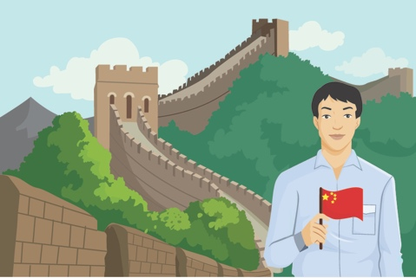

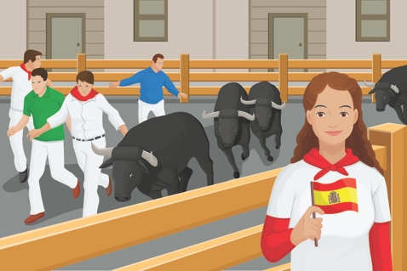
Part 2.0: Target Language
Activity 2.1: Practice
Make three sentences for each picture. Say where the person is from,
his/her nationality, and what language s/he speaks.
A
B
C
D
Notes:
2.1 Where Are They From?
Allow three minutes for this slide.
INSTRUCTIONS
The Students take turns making sentences to describe the pictures, following the pattern in the Context Creation. For example,
Student A: He’s from France. He’s French. He speaks French.
Student B: She’s from England/Great Britain. She’s English. She speaks English.
…
Allow two minutes for the Students to describe the pictures.
Go through the answers in open class, eliciting at least one full answer from each Student in turn.
Allow one minute for this section.
ANSWER KEY
A. He’s from France. He’s French. He speaks French.
B. He’s from China. He’s Chinese. He speaks Chinese.
C. She’s from England. She’s English. She speaks English.
D. She’s from Spain. She’s Spanish. She speaks Spanish.
TEACHING TIP
Note any images from the activity that cause problems, and review them at the end of the activity.

Slide 8

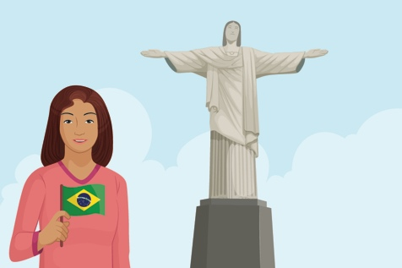


Part 2.0: Target Language
Activity 2.1: Practice
Make three sentences for each picture. Say where the person is from,
his/her nationality, and what language s/he speaks.
A
B
C
D
Notes:
2.1 Where Are They From?
Allow three minutes for this slide.
INSTRUCTIONS
The Students take turns making sentences to describe the pictures, following the pattern in the Context Creation. For example,
Student A: He’s from Italy. He’s Italian. He speaks Italian.
Student B: She’s from Brazil. She’s Brazilian. She speaks Portuguese.
…
Allow two minutes for the Students to describe the pictures.
Go through the answers in open class, eliciting at least one full answer from each Student in turn.
Allow one minute for this section.
ANSWER KEY
A. He’s from Italy. He’s Italian. He speaks Italian.
B. She’s from Brazil. She’s Brazilian. She speaks Portuguese.
C. He’s from Russia. He’s Russian. He speaks Russian.
D. She’s from Germany. She’s German. She speaks German.
TEACHING TIP
Note any images from the activity that cause problems, and review them at the end of the activity.

Slide 9

Part 2.0: Target Language
Activity 2.1: Extension
Notes:
2.1 Where Are They From?
Optional Extension
INSTRUCTIONS
Say to the Students, “Tell me about (storyline character/famous person).” For example, “Tell me about Shen/Sofi/Taylor Swift.”
Elicit a sentence, such as, “Shen’s from China. He’s Chinese. He speaks Chinese.”
Say, “Work together to make three sentences about characters from the storyline or famous people. Make sentences about five different people.”
Have the Students talk with their classmates, taking turns to make sentences. Then review their sentences as a class.

Slide 10
Part 2.0: Target Language
Activity 2.1: Feedback
Student 1
Student 2
Student 3
Student 4
Great job!
Great job!
Great job!
Great job!
Well done
Well done
Well done
Well done
Good try
Good try
Good try
Good try
More practice
More practice
More practice
More practice
Feedback
Notes:
2.1 Where Are They From?
FEEDBACK
Quickly give the Students feedback on the target language they just practiced.
Remind them of other resources they can take advantage of to improve their English:
Go to Wall Street World to practice grammar and vocabulary.
Review the Student Manual or Digital Book to study grammar and vocabulary.
Attend Complementary Classes to practice using grammar and vocabulary.
Join Social Clubs to practice speaking skills.

Slide 11
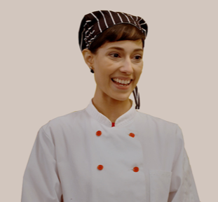
Part 3.0: Target Structures
Activity 3.1: Context Creation
What/name?
Where/from? How/old? When/go/museum? Why/live/New York City?
Sofi
?
What's her name
31 years old
From France
Chef
Hobbies: cooking, watching
TV, going to museums
.
Her name is Sofi
Notes:
3.1 Character Interviews (10 min)
Allow one minute for this slide.
OBJECTIVES
Can describe facts and states with the present simple, but with limited control (He's nice and he wants to talk to you.)
Can use what, where, when, why and how to ask for information (When do you visit your parents?)
INSTRUCTIONS
#1. Draw the Students’ attention to the cue words at the top of the screen [What/name? Where/from? How/old? When/go/museum? Why/live/New York City?] and the image of Sofi.
#2. Draw the Students’ attention back to the first set of cue words at the top of the screen. [What/name?]
#3. Have the Students ask the corresponding question.
#4. Reveal the question. [What’s her name?]
#5. Encourage the Students to answer.
#6. Reveal the answer. [Her name is Sofi.]
TEACHING TIPS
Elicit examples of the target structure(s).
Elicit from each Student.
It helps to board elicited language.

Slide 12
Part 3.0: Target Structures
Activity 3.1: Concept Check
Where/from? How/old? When/go/museum? Why/live/New York City?
Sofi
?
?
Where’s she from
How old is she
31 years old
From France
Chef
Hobbies: cooking, watching
TV, going to museums
?
?
Why does she live in New York City
When does she go to a museum
Notes:
3.1 Character Interviews
Allow one minute for this slide.
INSTRUCTIONS
#1. Concept check by returning the Students’ attention to the cue words at the top of the screen ” [Where/from? How/old? When/go/museum? Why/live/New York City?] and asking, “What other questions can we ask?
#2. Encourage the Students to say the corresponding questions.
#3. Reveal the answers. [Where’s she from?/How old is she?/When does she go to a museum?/Why does she live in New York City?]
TEACHING TIP
Elicit target language from each Student.

Slide 13

Part 3.0: Target Structures
Activity 3.1: Practice
What? Where? How? When? Why?
?
Aanya
29 years old
From India
Engineer
Hobbies: going to the gym;
watching movies, going out
with friends
.
Notes:
3.1 Character Interviews
Allow two minutes for this slide.
INSTRUCTIONS
The Students should take turns asking questions with each of the question words at the top of the screen. For example,
What’s her name?
Where is she from?
Etc.
ANSWER KEY (sample answers)
What’s her name?
What’s her job?
What are her hobbies?
Where is she from?
Where does she work?
How old is she?
When does she go to the gym?
Why does she like/live in New York?
TEACHING TIPS
Encourage the Students to ask different questions about the hobbies for each character to elicit questions with “when” and “why.” For example, “Why does she like going to the gym?” “When does she go to the gym?”
Insist on full sentences and encourage the Students to invent information about the characters if needed.
If you have a stronger group, have the Students make two questions with each question word.

Slide 14

Part 3.0: Target Structures
Activity 3.1: Practice
What? Where? How? When? Why?
?
Marco
Age 33
From New York
Architect
Hobbies: going to
museums, shopping,
playing sports
.
Notes:
3.1 Character Interviews
Allow two minutes for this slide.
INSTRUCTIONS
The Students should take turns asking questions with each of the question words at the top of the screen, for example,
What’s his name?
Where is he from?
Etc.

Slide 15
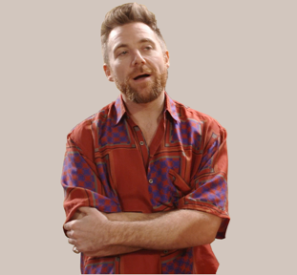
Part 3.0: Target Structures
Activity 3.1: Practice
What? Where? How? When? Why?
?
Benny
Age 25
From England
Was a salesperson
Hobbies: watching football
on TV, sleeping,
playing video games
.
Notes:
3.1 Character Interviews
Allow two minutes for this slide.
INSTRUCTIONS
The Students should take turns asking questions with each of the question words at the top of the screen, for example,
What’s his name?
Where is he from?
Etc.

Slide 16
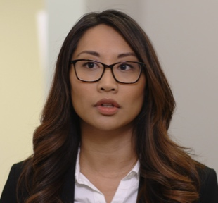
Part 3.0: Target Structures
Activity 3.1: Practice
What? Where? How? When? Why?
?
Khae
30 years old
From Thailand
Designer
Hobbies: going to the gym,
eating healthy, going to
restaurants
.
Notes:
3.1 Character Interviews
Allow two minutes for this slide.
INSTRUCTIONS
The Students should take turns asking questions with each of the question words at the top of the screen, for example,
What’s her name?
Where is she from?
Etc.

Slide 17

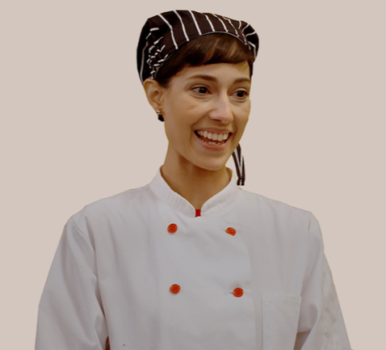
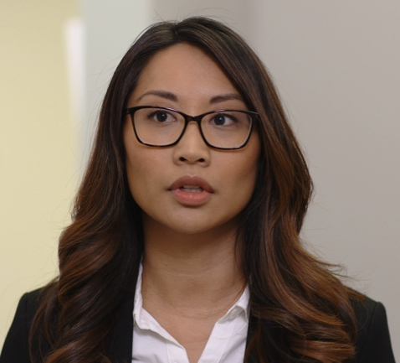
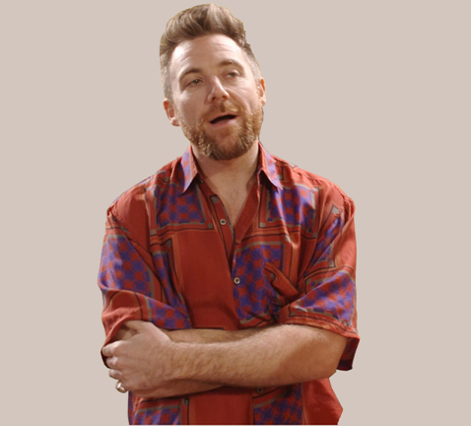

Part 3.0: Target Structures
Activity 3.1: Extension
What? Where? How? When? Why?
Notes:
3.1 Character Interviews
Optional Extension
INSTRUCTIONS
The Students take turns taking on the role of one of the characters on the screen. Their classmates try to guess who they are, using the target words to ask questions. For example,
What’s your job?
Where are you from?
Etc.
When the Students answer the questions, they can use their own information or make up answers.

Slide 18
Part 3.0: Target Structures
Activity 3.1: Feedback
Student 1
Student 2
Student 3
Student 4
Great job!
Great job!
Great job!
Great job!
Well done
Well done
Well done
Well done
Good try
Good try
Good try
Good try
More practice
More practice
More practice
More practice
Feedback
Notes:
3.1 Character Interviews
FEEDBACK
Quickly give the Students feedback on the target language they just practiced.
Remind them of other resources they can take advantage of to improve their English:
Go to Wall Street World to practice grammar and vocabulary.
Review the Student Manual or Digital Book to study grammar and vocabulary.
Attend Complementary Classes to practice using grammar and vocabulary.
Join Social Clubs to practice speaking skills.

Slide 19

Part 4.0: Communication
Activity 4.1: Context Creation
.
?
?
.
?
Notes:
4.1 Guess Who? (15 min)
Allow two minutes for this slide.
OBJECTIVES
Can describe facts and states with the present simple, but with limited control (He's nice and he wants to talk to you.)
Can use what, where, when, why and how to ask for information (When do you visit your parents?)
Can ask and answer simple questions about people they know in a limited way (Sofi, what’s that man’s name?)
INSTRUCTIONS
Tell the Students, “I'm thinking of a living famous person. I can't tell you this person's name, but I can answer any other questions. Ask me questions to find out the famous person’s name.”
Elicit questions, for example,
Where does s/he live?
Is this person a man or a woman?
What is his/her job?
Does s/he have children?
Answer the Students' questions until they can guess the name of the famous person.
TEACHING TIPS
For the example in open class, choose a famous local celebrity so that the Students can get the answer quickly and begin the activity independently.
Brainstorm/elicit a variety of the target language, which will be used and assessed during the practice.
Elicit from each Student.
It helps to board elicited language.

Slide 20
Part 4.0: Communication
Activity 4.1: Practice
.
.
Notes:
4.1 Guess Who?
Allow thirteen minutes for this slide.
INSTRUCTIONS
The Students take turns thinking of a famous person for their classmates to guess in the same way.
TEACHING TIPS
Use a stopwatch to time each round of questions to make the activity more fast-paced.
Make sure the Students choose current celebrities, rather than historical figures, so that the need to use past verb forms does not arise.

Slide 21
Part 4.0: Communication
Activity 4.1: Feedback
 |  | Great job! | Well done | Good try | Need more practice
Student 1 | Range: How well you produce a range of language
 | Accuracy: How often you make mistakes
 | Quality of interaction: How well you ask and answer questions
 | Fluency and Spoken Production: How clearly you present ideas
Student 2 | Range: How well you produce a range of language
 | Accuracy: How often you make mistakes
 | Quality of interaction: How well you ask and answer questions
 | Fluency and Spoken Production: How clearly you present ideas
Student 3 | Range: How well you produce a range of language
 | Accuracy: How often you make mistakes
 | Quality of interaction: How well you ask and answer questions
 | Fluency and Spoken Production: How clearly you present ideas
Student 4 | Range: How well you produce a range of language
 | Accuracy: How often you make mistakes
 | Quality of interaction: How well you ask and answer questions
 | Fluency and Spoken Production: How clearly you present ideas
Notes:
4.1 Guess Who?
FEEDBACK
Quickly give the Students feedback on the target language they just practiced.
If you have a full class, focus on just a couple points each (i.e., their greatest strength and what they need to work on).
Remind them of other resources they can take advantage of to improve their English:
Go to Wall Street World to practice grammar and vocabulary.
Review the Student Manual or Digital Book to study grammar and vocabulary.
Attend Complementary Classes to practice using grammar and vocabulary.
Join Social Clubs to practice speaking skills.

Slide 22

Part 4.0: Communication
Activity 4.2: Context Creation
1. Shen is from China.
?
Can you ask me questions to find this information?
2. Shen speaks Chinese
and English.
Where is Shen from
3. Shen wakes up at eight o’clock.
4. Shen lives with Benny because
New York is expensive.
?
What languages does Shen speak
?
?
When does Shen wake up
Why does Shen live with Benny
Notes:
4.2 Marc and Maria (15 min)
Allow two minutes for this slide.
OBJECTIVES
Can name very common nationalities based on country names (Is he American?)
Can name very well-known nations, nationalities, and languages (Canadian; American; British; French; Thai; Chinese; Russian; German; Spanish; Mexican; Italian)
Can describe facts and states with the present simple, but with limited control (He's nice and he wants to talk to you.)
Can use what, where, when, why and how to ask for information (When do you visit your parents?)
INSTRUCTIONS
#1. Draw the Students’ attention to the statements about Shen. [Shen is from China./Shen speaks Chinese and English./Shen wakes up at eight o’clock./Shen lives with Benny because New York is expensive.]
#2. Have a Student read the question. [Can you ask me questions to find this information?]
#3. Encourage Students to say the question corresponding to the first statement.
#4. Reveal the answer. [Where is Shen from?]
#5. Encourage the Students to say the question corresponding to the second statement.
#6. Reveal the answer. [What languages does Shen speak?]
#7. Encourage the Students to say the question corresponding to the third statement.
#8. Reveal the answer. [When does Shen wake up?]
#9. Encourage the Students to say the question corresponding to the fourth statement.
#10. Reveal the answer. [Why does Shen live with Benny?]
TEACHING TIPS
Brainstorm/elicit a variety of the target language, which will be used and assessed during the practice.
Elicit from each Student.
It helps to board elicited language.

Slide 23

Part 4.0: Communication
Activity 4.2: Practice
Scenario
Student A
Student B
Ask your partner questions about Maria. Languages?
From?
Lives?
Why/lives in…?
Job?
When/wakes up?
Answer your partner’s questions about Maria. Age: 32 From: Spain Speaks: Spanish, English Lives in: New York Job: Teacher Maria lives in New York because she loves big cities. She is a teacher because she loves children. Maria loves to sleep. On the weekends, she wakes up at eleven o’clock in the morning.
Notes:
4.2 Marc and Maria
Allow seven minutes for this slide.
INSTRUCTIONS
Call out two Students. Tell them to ask and answer questions to find out about Maria.
Have the Students discuss, using the question prompts and the information on the screen. Then have them switch roles and do the activity again.
Afterward, have each Student say at least two things they learned about Maria. For example,
Maria is from Spain, and she’s Spanish.
She lives in New York and speaks English and Spanish.
TEACHING TIPS
Ask the Students to speak in full sentences.
If you have a weaker group or if the Students need extra practice, have the Students repeat the activity, using the prompts on the next screen.

Slide 24

Part 4.0: Communication
Activity 4.2: Practice
Scenario
Student C
Student D
Ask your partner questions about Marc. Languages? From? Lives? Why/lives in…? Job? When/wakes up?
Answer your partner’s questions about Marc. Age: 28 From: France Speaks: French, German, English Lives in: Berlin Job: Engineer Marc lives in Berlin because his wife is German. He has two sons. They are 6 and 8 years old. Marc works many hours. He wakes up at five in the morning and doesn’t come home until late at night.
Notes:
4.2 Marc and Maria
Allow six minutes for this slide.
INSTRUCTIONS
Call out two Students. Tell them to ask and answer questions to find out about Marc.
Have the Students discuss, using the question prompts and the information on the screen. Then have them switch roles and do the activity again.
Afterward, have each Student say at least two things they learned about Marc. For example,
Marc is an Engineer. He speaks French, English, and German. He is from France.
TEACHING TIPS
Ask the Students to speak in full sentences.
If you have a weaker group or if Students need extra practice, have the Students repeat the activity, using the prompts on the previous screen.

Slide 25
Part 4.0: Communication
Activity 4.2: Feedback
 |  | Great job! | Well done | Good try | Need more practice
Student 1 | Range: How well you produce a range of language
 | Accuracy: How often you make mistakes
 | Quality of interaction: How well you ask and answer questions
 | Fluency and Spoken Production: How clearly you present ideas
Student 2 | Range: How well you produce a range of language
 | Accuracy: How often you make mistakes
 | Quality of interaction: How well you ask and answer questions
 | Fluency and Spoken Production: How clearly you present ideas
Student 3 | Range: How well you produce a range of language
 | Accuracy: How often you make mistakes
 | Quality of interaction: How well you ask and answer questions
 | Fluency and Spoken Production: How clearly you present ideas
Student 4 | Range: How well you produce a range of language
 | Accuracy: How often you make mistakes
 | Quality of interaction: How well you ask and answer questions
 | Fluency and Spoken Production: How clearly you present ideas
Notes:
4.2 Marc and Maria
FEEDBACK
Quickly give the Students feedback on the target language they just practiced.
If you have a full class, focus on just a couple points each (i.e., their greatest strength and what they need to work on).
Remind them of other resources they can take advantage of to improve their English:
Go to Wall Street World to practice grammar and vocabulary.
Review the Student Manual or Digital Book to study grammar and vocabulary.
Attend Complementary Classes to practice using grammar and vocabulary.
Join Social Clubs to practice speaking skills.

Slide 26
Encounter 20
Overall Feedback
 |  | Great job! | Well done | Good try | Need more practice
 | Activity 2.1: Where Are They From?
 | Activity 3.1: Character Interviews
 | Activity 4.1: Guess Who?
 | Activity 4.2: Marc and Maria
Student 1
Feedback
Notes:
OVERALL FEEDBACK (3–5 min)
Allow one minute for this slide.
Explain to the Students that you will now be giving them an overall assessment and recommendations. Use the following prompts to help you explain the assessment:
First, you did a really good job of…
The areas where you could use a little more practice are…
The language points I didn’t hear you use were...
As a result, I’d recommend that you… [continue on to Unit 21… work on (X, Y, Z ) and repeat Encounter 20].
Do you have any questions?

Slide 27
Encounter 20
Overall Feedback
 |  | Great job! | Well done | Good try | Need more practice
 | Activity 2.1: Where Are They From?
 | Activity 3.1: Character Interviews
 | Activity 4.1: Guess Who?
 | Activity 4.2: Marc and Maria
Student 2
Feedback
Notes:
OVERALL FEEDBACK (3–5 min)
Allow one minute for this slide.
Explain to the Students that you will now be giving them an overall assessment and recommendations. Use the following prompts to help you explain the assessment:
First, you did a really good job of…
The areas where you could use a little more practice are…
The language points I didn’t hear you use were...
As a result, I’d recommend that you… [continue on to Unit 21… work on (X, Y, Z ) and repeat Encounter 20].
Do you have any questions?

Slide 28
Encounter 20
Overall Feedback
 |  | Great job! | Well done | Good try | Need more practice
 | Activity 2.1: Where Are They From?
 | Activity 3.1: Character Interviews
 | Activity 4.1: Guess Who?
 | Activity 4.2: Marc and Maria
Student 3
Feedback
Notes:
OVERALL FEEDBACK (3–5 min)
Allow one minute for this slide.
Explain to the Students that you will now be giving them an overall assessment and recommendations. Use the following prompts to help you explain the assessment:
First, you did a really good job of…
The areas where you could use a little more practice are…
The language points I didn’t hear you use were...
As a result, I’d recommend that you… [continue on to Unit 21… work on (X, Y, Z ) and repeat Encounter 20].
Do you have any questions?

Slide 29
Encounter 20
Overall Feedback
 |  | Great job! | Well done | Good try | Need more practice
 | Activity 2.1: Where Are They From?
 | Activity 3.1: Character Interviews
 | Activity 4.1: Guess Who?
 | Activity 4.2: Marc and Maria
Student 4
Feedback
Notes:
OVERALL FEEDBACK (3–5 min)
Allow one minute for this slide.
Explain to the Students that you will now be giving them an overall assessment and recommendations. Use the following prompts to help you explain the assessment:
First, you did a really good job of…
The areas where you could use a little more practice are…
The language points I didn’t hear you use were...
As a result, I’d recommend that you… [continue on to Unit 21… work on (X, Y, Z ) and repeat Encounter 20].
Do you have any questions?

Slide 30
Part 5.0: Wrap-Up
How do you spell …
A
B
C
D
Notes:
5.1 Spelling Bee (5 min)
Allow three minutes for this slide.
OBJECTIVE
• To review and practice target language from the Unit
INSTRUCTIONS
#1. Ask the Students, “How do you spell France?” Then elicit the correct spelling.
Next, ask, “How do you spell French?” and elicit the correct spelling.
#2. Ask the Students, “How do you spell China?” Then elicit the correct spelling.
Next, ask, “How do you spell Chinese?” and elicit the correct spelling.
#3. Ask the Students, “How do you spell England?” Then elicit the correct spelling.
Next, ask, “How do you spell English?” and elicit the correct spelling.
#4. Ask the Students, “How do you spell Spain?” Then elicit the correct spelling.
Next, ask, “How do you spell Spanish?” and elicit the correct spelling.

Slide 31
Part 5.0: Wrap-Up
How do you spell …
A
B
C
D
Notes:
5.1 Spelling Bee
Allow two minutes for this slide.
INSTRUCTIONS
#1. Ask the Students, “How do you spell Italy?” Then elicit the correct spelling.
Next, ask, “How do you spell Italian?” and elicit the correct spelling.
#2. Ask the Students, “How do you spell Brazil?” Then elicit the correct spelling.
Next, ask, “How do you spell Brazilian?” and elicit the correct spelling.
#3. Ask the Students, “How do you spell Russia?” Then elicit the correct spelling.
Next, ask, “How do you spell Russian?” and elicit the correct spelling.
#4. Ask the Students, “How do you spell Germany?” Then elicit the correct spelling.
Next, ask, “How do you spell German?” and elicit the correct spelling.

Slide 32

Thank you for coming.
We hope you enjoyed the class.
Don’t forget
to leave feedback!
Teacher
Class was fun
Instructions were clear
«««««
«««««
«««««
«««««
«««««
«««««

Slide 33
© 2017 by Pearson Education Limited All rights reserved.
No part of this publication may be reproduced, stored in a retrieval system, or transmitted in any form or by any means, electronic, mechanical, photocopying, recording or otherwise without the permission of the Publishers.
This material is the intellectual property of Pearson Education Limited.
Image Credits:
willypd/Fotolia; Milles Studio/Fotolia

